Slide 1

Course: Educational Practice
Student: Ondiris Bibisara
Group: SE2001
Instructor: Aidana Kalakova
Astana IT university
2020 year

Slide 2
Agenda
Introduction
Project
Conclusion

Slide 3

Introduction
OLX - an online ad platform that engages people to buy, sell, or exchange goods and services.
The purpose of the project is to show all information about a person and action.

Slide 4
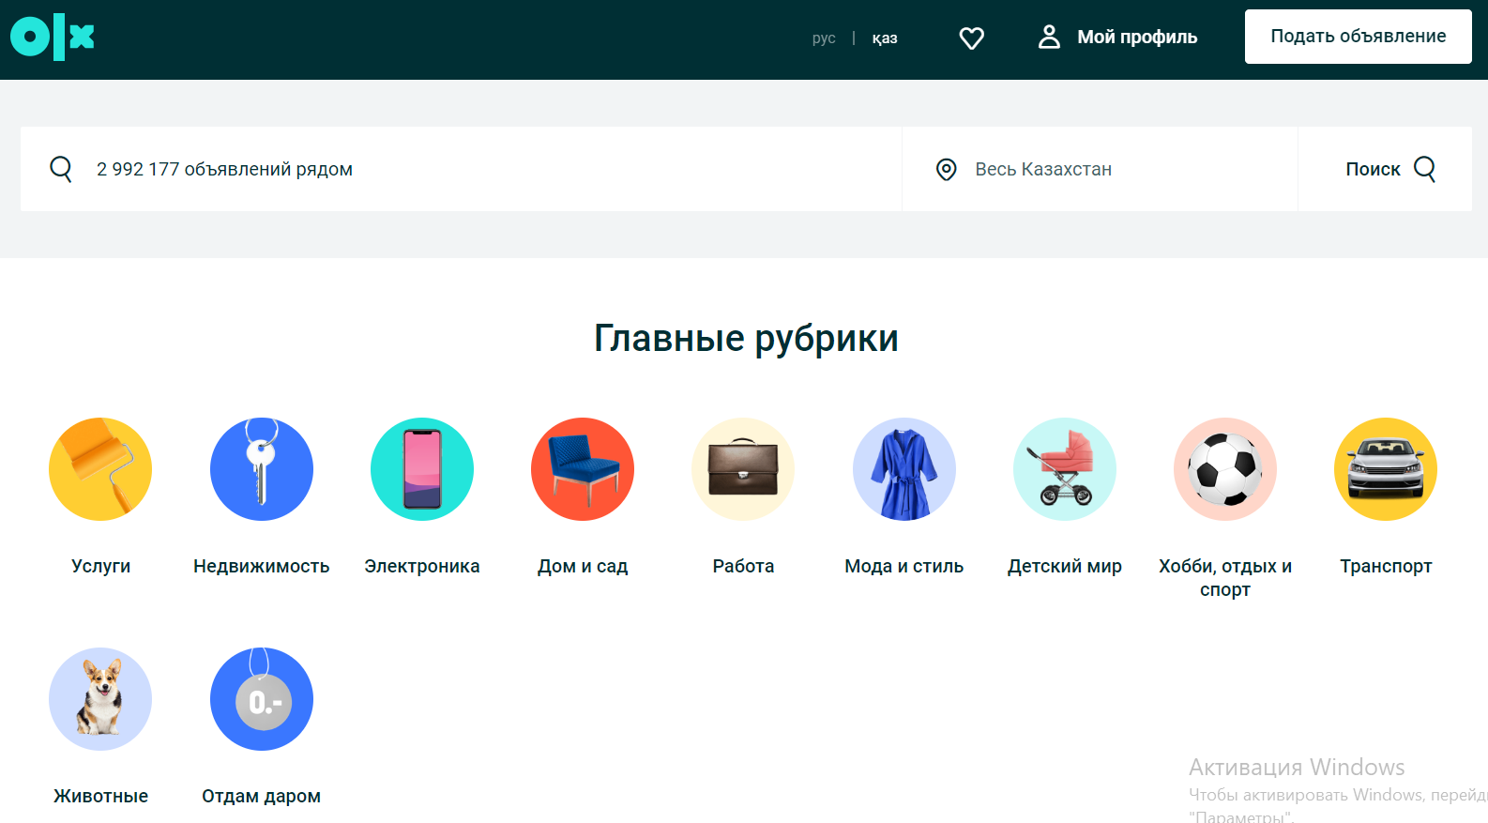
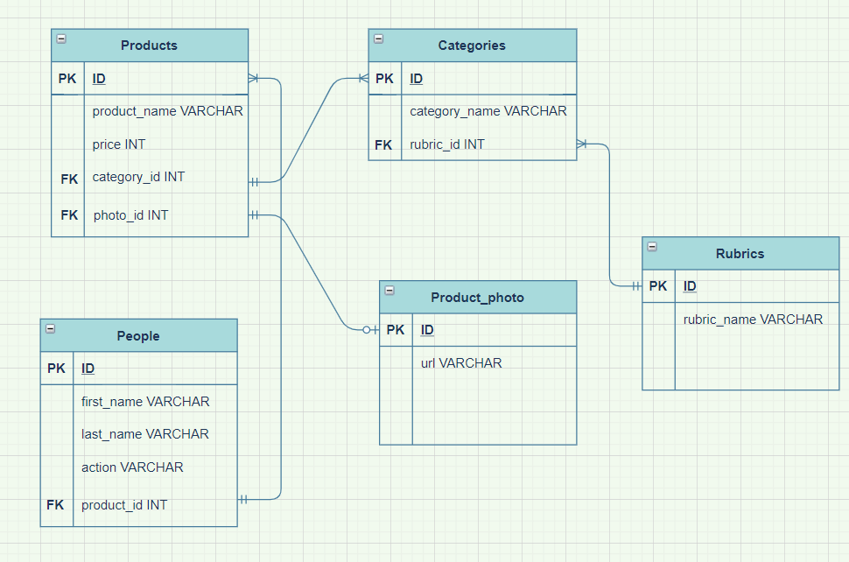
Project

Slide 5
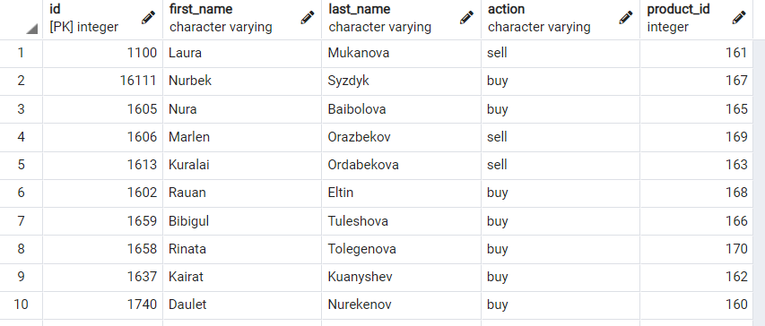
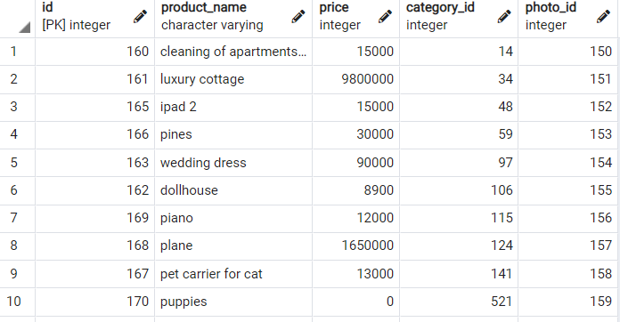
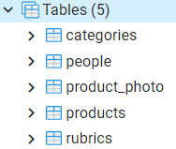
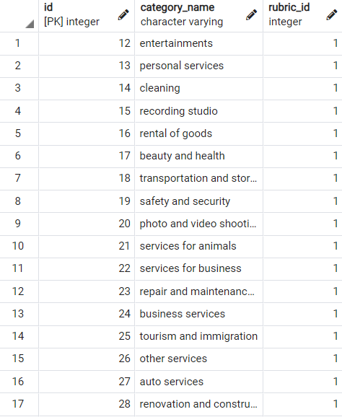
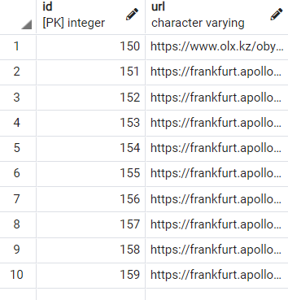
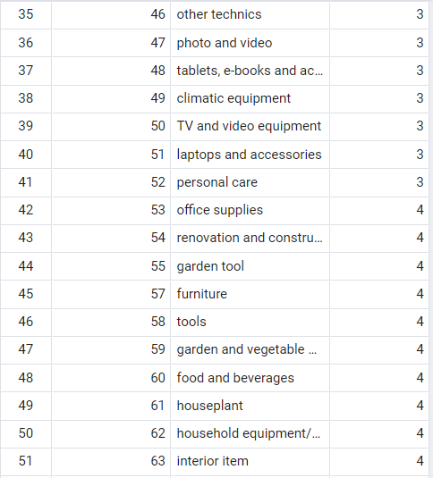
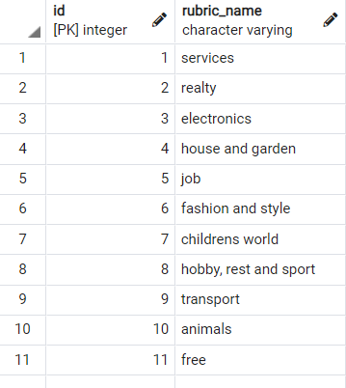
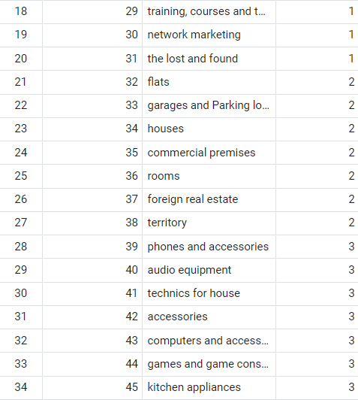
Project

Slide 6
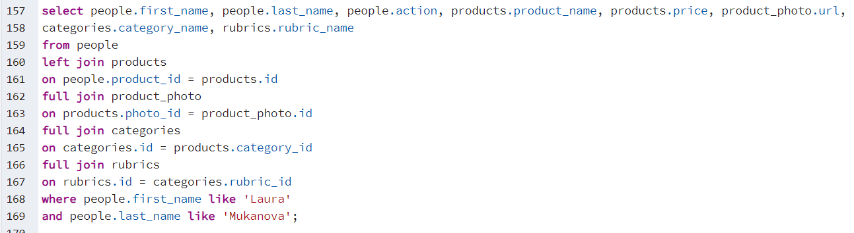
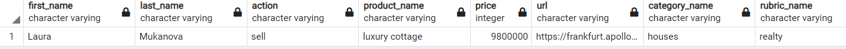
Project

Slide 7




Conclusion

Slide 8
Thanks for attention

